Slide 1

How Does AI Work?
Part 2: Neural Networks
© 2020 The Atticus Project

Slide 2
Review of Previous Presentation
Previous Presentation on How Does AI Work? Part 1: Pattern Recognition here.
Input → Machine Learning Model → Output.
Machine Learning models utilize pattern recognition to predict and classify data inputs.
A simple type of pattern recognition is Nearest Neighbor, where input is categorized based on its proximity to existing data points.

Slide 3
Neural Networks
Neural Networks are fundamentally
still a pattern recognition
system.

Slide 4
Neural Networks (cont.)
A neural network is a type of ML model that consists of a set of connected nodes where each node assigns weights to its inputs.
Node: a basic building block of neural networks that assigns weights to inputs.
Weight: a set of numbers that make up the model.
E.g. list of words/sentences in the contract
Input
Weight
Accumulate
Output

Slide 5
From Neural Networks to Deep Learning
"Deep" learning refers to a type of ML model that uses layers of neural networks.
This allows it to make more complex decisions, like speech-to-text, sentiment detection, and text summarization.
Nowadays, almost all models have multiple layers, and some have hundreds of layers.
Input
Weight
Input
Weight
Input
Weight
Accumulate
Accumulate
Output
Accumulate
Output
Output
Layer 1
Layer 2
Layer 3

Slide 6

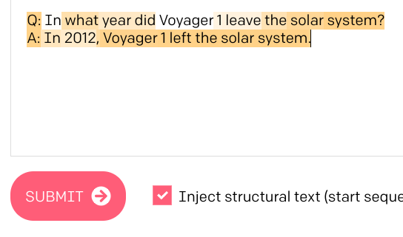


Output
The AI will then produce an output in a format that humans can understand.
A simple output would be the probability of a clause being a Change of Control clause.
More advanced outputs, such as long text, images, and graphs, etc., require additional processing.

Slide 7



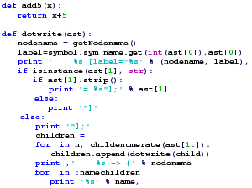
Review of Steps
Input
Machine Learning Model
Output
Pre-processing, usually done using a simpler program.
Based on Pattern Recognition
Neural Networks: made of systems of nodes, communicating with each other
Deep Learning: Neural Networks with multiple layers of processing
AI produces an output humans can use and understand.

